Slide 1
2021 Primeau Law Future of Feminism Award:
The Importance of
Female Role Models
Emma Martin-Rousselle
3 Cartier Cir, Box 1866, Deep River, ON
Mackenzie Community School - Class of 2021

Slide 2
1.
Background
The barrier faced, my goal, and my personal experiences
with mentorship (and lack thereof)

Slide 3
Barrier: Some career fields are still considered “male-dominated” or “non-traditional” choices for female graduates. To achieve equality, this mindset needs to be eliminated. In addition, the lack of female role models in certain fields makes it difficult for young women to envision themselves being successful. Overall, this creates a need for mentorship and connections between successful women and young women.

Slide 4
Goal: To work to bridge the gap between female high school students and our community’s positive female role models, who can provide career guidance or mentorship to aspiring female students, especially for those considering “male-dominated” or “non-traditional” careers..

Slide 5
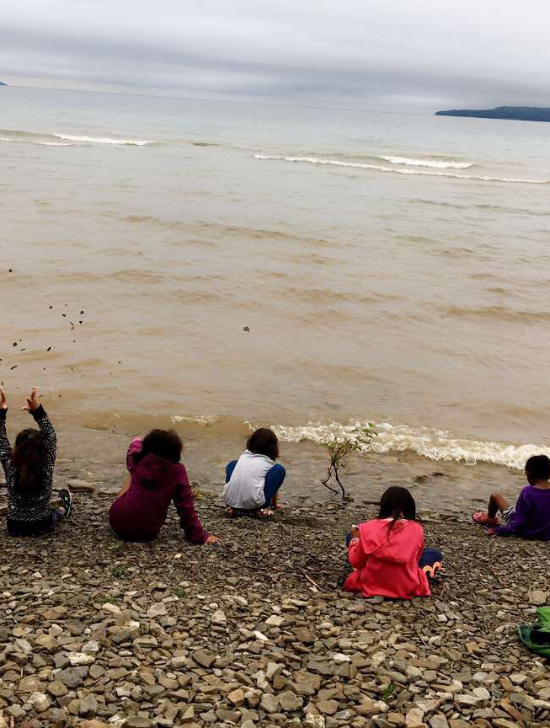
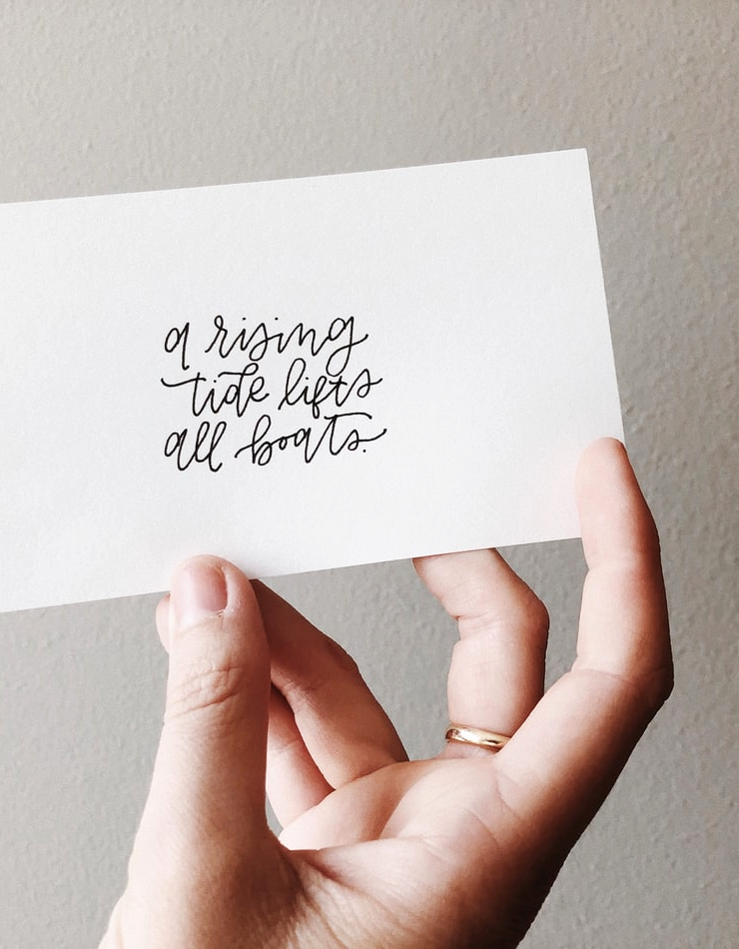
My cabin group at StepStones, Summer 2017
In the summer of 2017, I worked as a camp counselor at StepStones for Youth Camp in Wiarton, ON. The camp was created for underprivileged girls who are “struggling with their self-esteem or have a history of abuse” and who oftentimes “lack positive female role models”.
I had zero work experience and was only a year older than the oldest campers when encouraged to apply for the position. An experience that would stay with me for many years, it was invaluable, and shaped my perspective regarding my own privilege, inequalities in modern day society, and most importantly, the necessity for positive female role models for young women.

Slide 6
I discovered interactions with positive female role models helped these girls and young women gain self-confidence and learn skills to cope in a world full of inequalities. Although many students in our community have grown up in a healthy, nurturing environment, I feel this form of female mentorship would be beneficial to all young women.
There is a particular need within our community that I believe could be met on a smaller scale: support for female graduating students who may be struggling to navigate career options. Many graduating students have struggled with choosing a career path and deciding about post-secondary options. For female students who may wish to stray from ‘traditional’ pathways, or those who lack female role models in the fields that interest them, a female mentor would be immensely helpful.

Slide 7
Personally, I struggled when deciding about my own post-secondary pathway. Many of the women in my family are healthcare professionals and I was encouraged to follow in their footsteps. While I respect the field my mom, aunts, and cousins have chosen, healthcare was never something I have been passionate about. This left me with few female role models to discuss other career paths, and essentially alone. I felt lost in a sea of options.
For this reason, I blindly considered a range of post-secondary programs. I went from Journalism to Speech Pathology to Law to French Teaching before finally settling on a General Arts program at the University of British Columbia. I felt this was where I could explore my interests before declaring a major. While I am now at ease with my decision, I feel I would have greatly benefited from mentorship and guidance from a woman who had too been in my situation.

Slide 8
In order to combat these issues within our community, the solution I see would be a female mentorship program; particularly, I envision successful women in Deep River providing their contact information to students who wish to reach out and to learn more about their career path. In doing so, connections would be made and young women would be able to see and hear first-hand what is possible, despite gender barriers and lack of representation for women in the workplace.

Slide 9
2.
Planning
How I wish to achieve this project

Slide 10
DATABASE CREATION
EXPANSION
CONSIDERATION OF POTENTIAL ISSUES
1
3
5
2
4
CONTACT WITH POTENTIAL MENTORS
PUBLICITY

Slide 11
Consideration of Potential Issues
1
Motivation
How will students feel motivated and at ease with using this resource?
Reverse pairing: with permission and guidance from school officials, allow for mentors to reach out to students directly, rather than students reaching out to them.
Accessibility
What are the best methods to share this resource?
Social media: use platforms like Instagram, Facebook, TikTok and Snapchat for publicity
School officials: share information with guidance counselors, co-operative education teachers, Grade 10 careers teachers, as well as emails directly to student accounts
Confidentiality
How could we protect personal contact information from being abused?
To be determined:
while developing this project, confidentiality has been my main concern. There are legal ramifications regarding this and it is something that I am still considering.

Slide 12
Contact with Potential Mentors
2
Network with known successful female role models in Deep River and area, gauging interest for involvement in a mentoring program. I would also request suggestions from these women on other potential mentors who would be interested in bridging the gap between themselves and female high school students who might be struggling with career decisions or with a lack of positive female role models.

Slide 13
Database Creation
3
I would then create a database of known female role models and potential mentees. Such information would include names, contact information, careers, and education (if relevant to potential matching). Once this database is compiled a match will be made between interested young women and successful women within the community.
EXAMPLE | OCCUPATION | PREFERRED METHOD OF CONTACT | EDUCATION (IF RELEVANT)
Jane Doe | Chemical Engineer | doej@gmail.com | BASc in Chemical Engineering, McGill University
Susan Smith | Small Business Owner | susan@mybusiness.ca | N/A

Slide 14
Publicity
4
For the accessibility and impact of this project, I believe an important step would be taking multiple methods to share this information with students, including:
Share information with school officials, particularly, the guidance counsellor, co-operative education teacher, student success teachers, and Grade 10 careers teachers.
Mass-send information via school board email accounts
Employ social media and internet publicity, such as Mackenzie Student Council’s Instagram account; Town of Deep River website; and Primeau Law Facebook page.
With student and mentor consent, mentors could reach out to students, as suggested by school officials directly, rather than waiting for the student to reach out themselves.

Slide 15
Expansion
5
Assuming that the initial project is successful, there is the potential to include more contacts in more job fields and in more communities throughout the Ottawa Valley. There is also the potential for:
providing this resource to more young women, regardless of school affiliation or location.
Expand publicity towards students who do not identify as female or to young men who lack positive role models at home.
Expanding to provide mentors from a larger variety of jobs.

Slide 16
3.
Statistics
Statistical information as to why a project of this kind is so valuable

Slide 17
“Seeing is Believing”: “Women are much more likely to pursue a career if they are being empowered by seeing a woman in their career aspiration”
(Forbes, 2020)

Slide 18
The Influence of Role Models
As a young woman, it is easier to envision myself in a career when I see other women already succeeding in the same position. A 2015 study on role models, called “The Motivational Theory of Role Modeling: How Role Models Influence Role Aspirants’ Goals” echoed this, outlining the following benefits of role models:
Role models act as behavioral models;
Role models represent the possible; and
Role models are inspirational.
Another study from 2005 (“Do Faculty Serve as Role Models? The Impact of Instructor Gender on Female Students”) showed that female students were more likely to pursue a career in or choose a major in Science, Technology, Engineering and Mathematics (STEM), a field where women are often underrepresented, if their professor was female and if females were represented within the faculty.

Slide 19
Female Role Models Within Government
Although lack of female role models is most prevalent within STEM subjects, this extends into other fields as well, such as a field I have strongly considered myself: Political Science & Government. Although female presence has increased in politics, with Canada electing a record number of female MPs in 2019, this is still an issue today in both Canada and the US.
A 2007 study in the UK “Leading by Example: Female Members of Parliament as Political Role Models” found “where there are more female members of parliament (MPs), adolescent girls are more likely to discuss politics with friends and to intend to participate in politics as adults”, further proving the importance of female role models to all. Unfortunately, CBC News reported that only 29% of seats in the Canadian House of Commons are occupied by women, often deterring women from participating in politics as adults.

Slide 20
4.
Conclusion
Closing statements

Slide 21
Conclusion
To conclude, I believe that this opportunity would allow for young women in our region to feel more confident in their post-secondary endeavors, even if they are pursuing a non-traditional pathway. This would allow for successful women in Deep River to continue to give back to our community, sharing their wisdom and experience with a new generation of young women, therefore creating a cycle of positive change for future years of mentorship.
On a larger scale, non-traditional pathways can become more normalized. No job should be a ‘woman’s job’ or a ‘man’s job’ and women should have the same opportunities as men. By providing mentorship, we can begin to chip away at this outdated principle.

Slide 22
5.
Bibliography

Slide 23
Bettinger, Eric P., and Bridget Terry Long. “Do Faculty Serve as Role Models? The Impact of Instructor Gender on Female Students.” The American Economic Review, vol. 95, no. 2, 2005, pp. 152–157. JSTOR, www.jstor.org/stable/4132808.
Morgenroth, Thekla, et al. “The Motivational Theory of Role Modeling: How Role Models Influence Role Aspirants’ Goals.” Review of General Psychology, vol. 19, no. 4, Dec. 2015, pp. 465–483. Sage Journals, https://journals.sagepub.com/doi/abs/10.1037/gpr0000059
Raman-Wilms, Menaka. “2019 Saw a Record Number of Women Elected - but Gender Equity in the Commons Is Still Far off | CBC News.” CBCnews, CBC/Radio Canada, 29 Dec. 2019, www.cbc.ca/news/politics/women-mps-house-of-commons-2019-election-1.5404800.
StepStones for Youth. “Girls Overnight Summer Camp.” StepStones for Youth , n.d., www.stepstonesforyouth.com/our-programs/girls-summer-camp/.
Warrell, Dr Margie. “Seeing Is Believing: Female Role Models Inspire Girls To Think Bigger.” Forbes, Forbes Magazine, 12 Oct. 2020, www.forbes.com/sites/margiewarrell/2020/10/09/seeing-is-believing-female-role-models-inspire-girls-to-rise/.
Wolbrecht, Christina, and David E. Campbell. “Leading by Example: Female Members of Parliament as Political Role Models.” American Journal of Political Science, vol. 51, no. 4, 2007, pp. 921–939. JSTOR, www.jstor.org/stable/4620108.

